Slide 1

BIST 100 INDEX PREDıCTIOn
Using LSTM, GRU, and polynomial regression,
1-day and 15-day BIST 100 Index predictions are made.
Alaattin Burak Koçer
040210262
Depertmant of Electrics and Electronics Istanbul Technical University
kocera21@itu.edu.tr
Necati Vural
040220264
Depertmant of Electrics and Electronics Istanbul Technical University
vuraln22@itu.edu.tr
Yiğit Yılmaz Yanç
040210044
Depertmant of Electrics and Electronics Istanbul Technical University
yanc21@itu.edu.tr

Slide 2

cOnTENTS
Introduction
Literature Review
Dataset
System Model
Proposed Approach
Comparison of Models and Numerical Values
Conclusion

Slide 3

ı. INTRODUCTIOn
Importance of Financial Forecasting
Complexity of Financial Markets
Financial systems are affected by political, economic, and even psychological factors.
Volatility in Emerging Markets
In developing countries like Turkey, sudden market shifts are more frequent and harder to predict.
BIST 100 as an Economic Indicator of Turkey
The BIST 100 shows the performance of Turkey’s top companies and indicates economic stability.

Slide 4
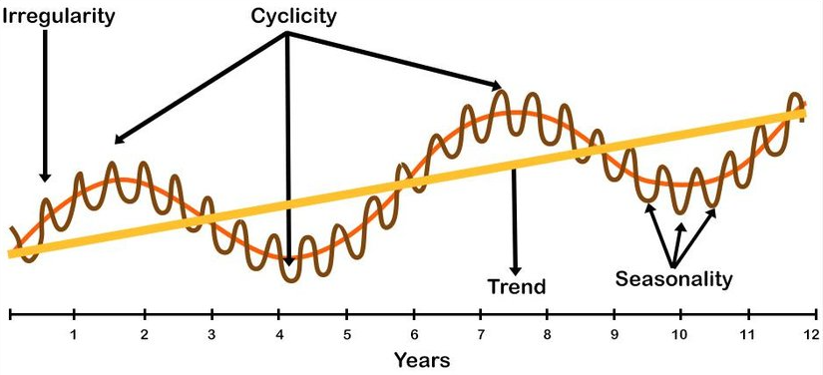
Challenges of Forecasting and the Role of ANN
Time Series are Nonlinear, Noisy
Financial time series often show irregular, unpredictable patterns over time.
Traditional Models are Limited
Models like ARIMA cannot adapt well to sudden changes or hidden patterns in the data.
ANN Offers Flexibility and Adaptability
Artificial Neural Networks can learn complex behaviors from data without strict assumptions.

Slide 5
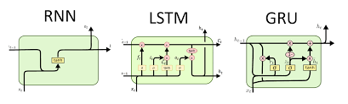
Why LSTM and GRU?
RNN Limitations (vanishing gradient)
Traditional RNNs have a problem with remembering long-term information during training.
LSTM and GRU as Advanced RNN Types
These models use gating mechanisms to manage information flow and memory.
Strength in Handling Long-Term Dependencies
Powerful in handling long-term dependencies and sudden changes.

Slide 6

Turkish Economic Context & Dataset Overview
Turkey's Sensitivity to Internal/External Factors
Exchange rates, inflation, and global crises heavily impact the Turkish market.
Dataset Range: 2021–2025
The study uses 4+ years of daily data, capturing both local and global indices.
Wide Range of Features: Macroeconomic, Global, technical
The dataset includes over 50 features from various economic and financial sources.

Slide 7
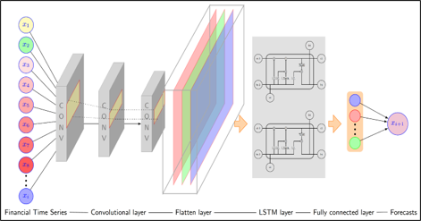
Iı. LıtERATURE REVIEW
ANN in Financial Forecasting
ANN is Increasingly Used in Finance
Neural networks are now common in financial forecasting due to their accuracy.
Strong at Modeling Non-linear, Multivariate Relationships
ANNs can handle multiple interacting features better than traditional models.
More Successful in Short-term Forecasting
Especially for short-term behaviours, neural networks perform better than classic methods.

Slide 8

Past Studies on BIST 100
Most Studies are Limited in Time and Features
Earlier research often used short datasets and lacked diverse inputs.
Use Only One Model
Many studies tested just one prediction model, missing comparison chance.
Lack Flexibility for Real-World Use
Models not tested on real-world-like conditions often fail in practice.

Slide 9

Deep Learning Strategies in the Literature
LSTM and GRU Outperform Classical Models
These deep learning models handle complex temporal patterns better.
Better at Learning Time Dependencies
They remember past information more effectively than traditional approaches.
Success in Volatile Series Like Stock Prices
They are robust to noise and sudden changes in financial data.

Slide 10

Contribution of This Study
Covers ~4 Years of Data
The study includes a long and rich dataset for more realistic results.
Compares ANN with Classical Models
LSTM, GRU, and polynomial regression are tested.
Uses Multiple Evaluation Metrics for Better Analysis
Metrics like RMSE, MAE, MAPE, and R² give a better overall view of the results.

Slide 11
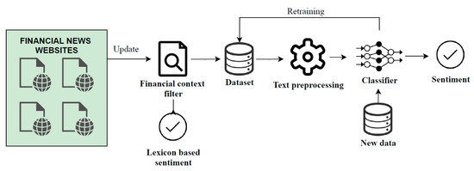
Future Works
Try Transformer-Based Models
Advanced models like Transformers may improve long-term forecasting..
Sentiment Analysis
Adding real-time text data could catch market sentiment more effectively.
Use Feature Selection or Ensemble Models
Selecting the best features or combining models may improve performance.

Slide 12

Iıı. dataset
Dataset Overview
Period: February 19 2021 – May 6 2025
Target: BIST 100 closing price
Total features: 59
Price action, technical indicators, macro variables, temporal features, inter-market links
Primary sources: Investing.com (prices, yields, CDS, global indices) & TradingEconomics.com (macroeconomic releases)
Extractions & preprocessing: Data merged in MATLAB, engineered and exported to Python for modeling

Slide 13
Feature Groups
Daily Price Action
Open, high, low, close, volume
Technical Indicators
EMA 20/50/200
RSI (14-day)
MACD (line, signal, histogram)
Bollinger Bands
ATR (14-day)
Cross-Market Metrics
Turkey 2- & 10-year bond yields & CDS
USD/TRY, XAU/USD
VIX, EEM, S&P 500, DAX, Nikkei
Macroeconomic Data
PMI, M2, inflation, policy & market rates, unemployment
GDP growth, Fed funds rate
Temporal Features
Day, week, month, quarter, year encoded as sine & cosine waves

Slide 14
Data Cleaning & Engineering
Missing / inconsistent records: Manual inspection → resampling & correction
No look-ahead bias: Future information removed
Cyclic time variables:
Converted with sin( 2πx/max ) & cos( 2πx/max ) to respect periodicity
Technical indicators: Generated via MATLAB Financial Toolbox + custom code
Macroeconomic release tracking:
feature_update (binary flag on release day)
days_since_update (elapsed days since last release)

Slide 15
Scaling & Model Readiness
Window-based normalization
MinMaxScaler & StandardScaler fitted only on training windows to avoid leakage
Binary flags and sine/cosine time features kept unscaled
Dimensionality reduction: Not applied (PCA optional)
Outcome: Clean, leakage-free 59-dimensional feature matrix ready for daily BIST 100 closing-price prediction.

Slide 16
Iv. System modeL
System Overview
Goal: Predict BIST 100 closing price 1 day and 15 days ahead
Models compared:
Long Short-Term Memory (LSTM)
Gated Recurrent Unit (GRU)
Polynomial Regression (baseline for non-linear trends)
Validation focus: Avoid over-/under-fitting & data-leakage
Assessment: Combine five quantitative metrics with visual diagnostics (actual vs predicted, residual plots)

Slide 17
Quantitative Evaluation Metrics
Metric | What it measures | Key point
RMSE | √(mean squared error) | Penalises large errors; same unit as price
R² | Goodness-of-fit (0–1) | 1 ≈ perfect explanation
MAE | Mean absolute error | Intuitive size of typical error
MAPE | % error of each point | Size-independent comparison
Accuracy | 1 – (MAE / mean price) | Closer to 100 % → better

Slide 18
RMSE = √[ (1 / n) · Σ (y_i − ŷ_i)² ]
R² = 1 − Σ (y_i − ŷ_i)² / Σ (y_i − ȳ)²
MAE = (1 / n) · Σ | y_i − ŷ_i |
MAPE (%) = (100 / n) · Σ | (y_i − ŷ_i) / y_i |
Accuracy = ( 1 − MAE / ȳ ) × 100

Slide 19
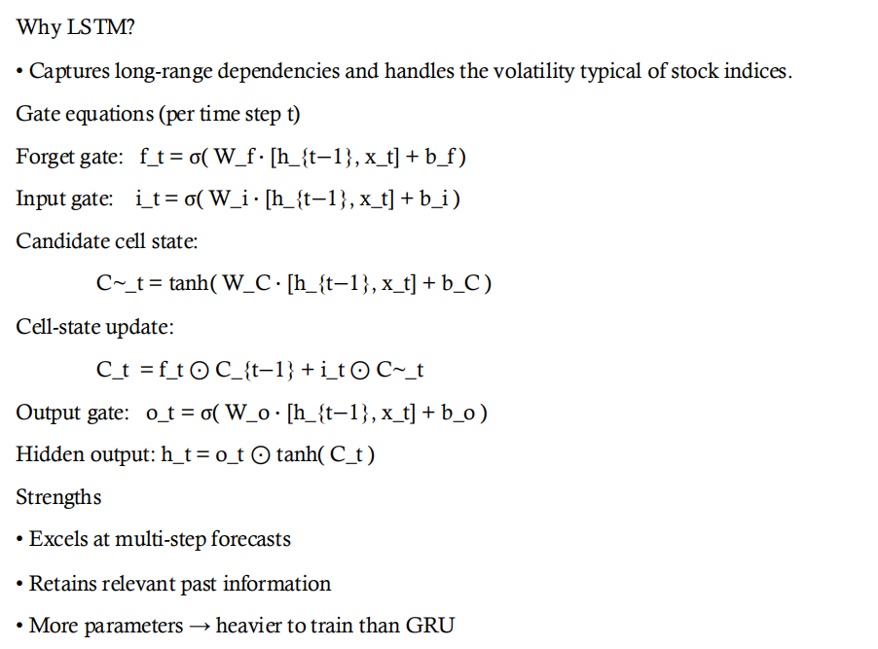
LSTM Architecture
Why LSTM?
• Captures long-range dependencies and handles the volatility typical of stock indices.
Gate equations (per time step t)
Forget gate: f_t = σ( W_f · [h_{t−1}, x_t] + b_f )
Input gate: i_t = σ( W_i · [h_{t−1}, x_t] + b_i )
Candidate cell state:
C~_t = tanh( W_C · [h_{t−1}, x_t] + b_C )
Cell-state update:
C_t = f_t ⊙ C_{t−1} + i_t ⊙ C~_t
Output gate: o_t = σ( W_o · [h_{t−1}, x_t] + b_o )
Hidden output: h_t = o_t ⊙ tanh( C_t )
Strengths
• Excels at multi-step forecasts
• Retains relevant past information
• More parameters → heavier to train than GRU

Slide 20
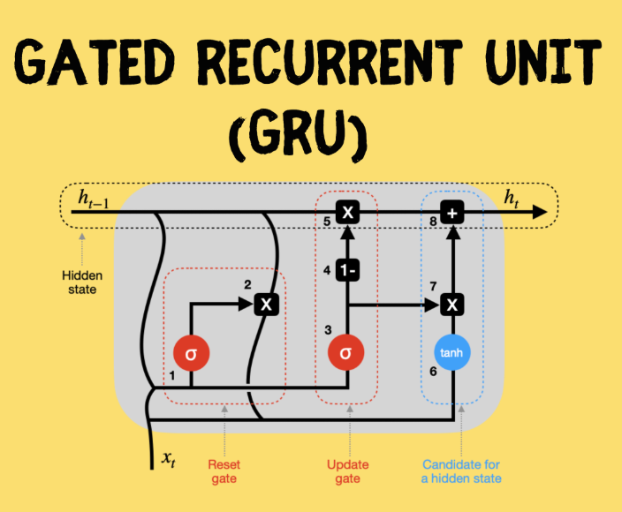
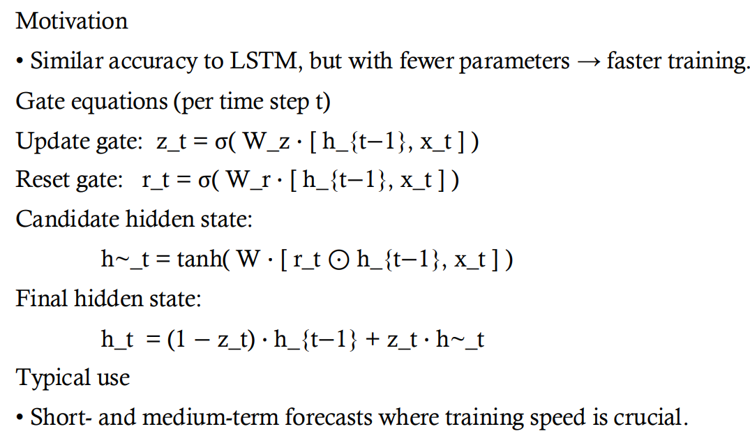
GRU Architecture
Motivation
• Similar accuracy to LSTM, but with fewer parameters → faster training.
Gate equations (per time step t)
Update gate: z_t = σ( W_z · [ h_{t−1}, x_t ] )
Reset gate: r_t = σ( W_r · [ h_{t−1}, x_t ] )
Candidate hidden state:
h~_t = tanh( W · [ r_t ⊙ h_{t−1}, x_t ] )
Final hidden state:
h_t = (1 − z_t) · h_{t−1} + z_t · h~_t
Typical use
• Short- and medium-term forecasts where training speed is crucial.

Slide 21
Polynomial Regression Baseline
Purpose: Simple benchmark for capturing near-term non-linear trends
Model equation:
y = β₀ + β₁ x + β₂ x² + … + βₙ xⁿ + ε
Key considerations:
Degree nnn tunes flexibility (higher ⇒ risk of overfit)
Linear least-squares after feature expansion
Serves as sanity-check against deep models

Slide 22
Training Protocol
Rolling-window training to mimic live trading
Hyper-parameter tuning (units, layers, dropout, polynomial degree) via grid search
Regularisation:
Dropout & early stopping for LSTM/GRU
Ridge penalty for high-degree polynomials
Data leakage safeguards:
Train/validation split strictly chronological
Scalers fit on training windows only

Slide 23
Qualitative Diagnostics
Actual vs Predicted plots highlight trend-tracking ability
Residual plots (errors over time & histogram) expose bias, heteroscedasticity, outliers
Interpretation strategy:
Random scatter ≈ well-calibrated model
Patterns ⇒ systematic error → revisit features or model complexity
Result summary: LSTM excelled in 15-day horizon; GRU offered fastest convergence; polynomial fit competitive for single-day moves but degraded on longer windows.

Slide 24
V. PROPOSED APPROACH
We propose two different approaches, one for 1-day predictions and the other for 15-day predictions

Slide 25
WALK-FORWARD ANALYSIS
In walk-forward analysis, we divide our samples into multiple "walks" in which we train and immediately test.
After each walk, we slide our samples and move through new samples in each walk.
This is continued as we reach the last samples whose number is enough to "walk" through.

Slide 26
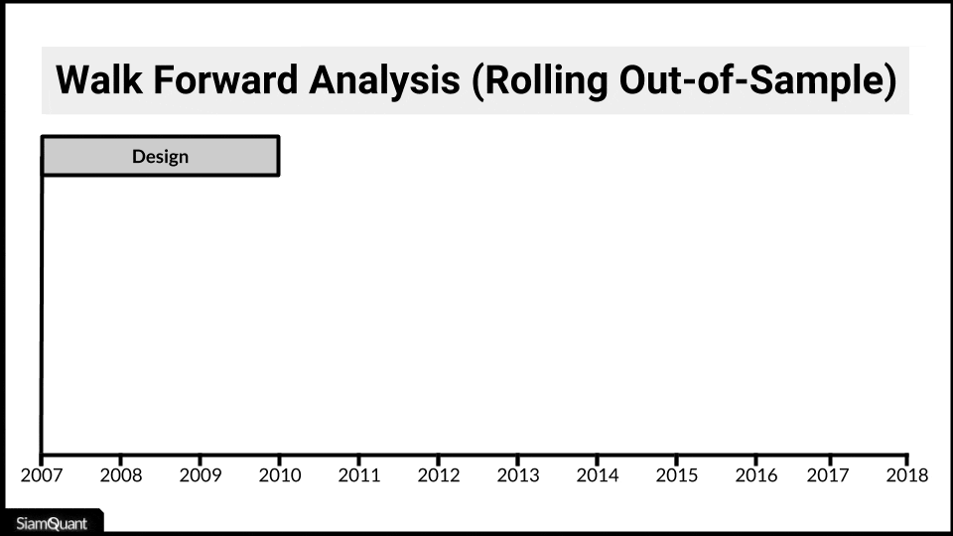
WALK-FORWARD ANALYSIS
We determine how many training and test samples there will be at the beginning, and also how many sample we will shift for the next walk.
The case where we shift the same number of testing samples is illustrated in the figure beside.
Adapted from https://www.siamquant.com/walk-forward/

Slide 27
PROPOSED APPROACH FOR 1-day predıctıons
For 1-day predictions, we use the walk-forward analysis in which our model trains for 10 models and tests for 1 day for each walk. Upon a walk, we shift our indices by 11, for our next walk.
In this case, our training and test samples are not overlapping.

Slide 28
PROPOSED APPROACH FOR 15-day predıctıons
For 15-day predictions the same logic is used, but in this case, we make sure that our samples are spaced by 15 days. Otherwise, we will end up with overlapping training and test prediction that will make harder us to evaluate and plot them.

Slide 29
PROPOSED APPROACH FOR 15-day predıctıons
Furthermore, unlike the set-up we used for our 1-day predictions, we set the shift equal to the number of test samples, which in our case is 1. We train for 10 samples, and test for 1 sample in each walk, then shift our indices by 1 for the next walk. For this case, we have overlapping training samples and predictions, but our test predictions don’t overlap.

Slide 30
PROPOSED APPROACH FOR 15-day predıctıons
Since our test predictions don’t overlap unlike the training predictions, we depict all our test predictions in a single plot.
Adapted from https://www.siamquant.com/walk-forward/

Slide 31
PROPOSED APPROACH FOR 15-day predıctıons
Using LSTM, GRU, and polynomial regression, these explained set-ups for 1-day and 15-day predictions are implemented.
In LSTM, and GRU we use "tanh" activation.

Slide 32

VI. COMPARASION OF models and numerıcal values
A detailed comparison between LSTM, GRU, and polynomial regression from evaluation metrics and plots

Slide 33
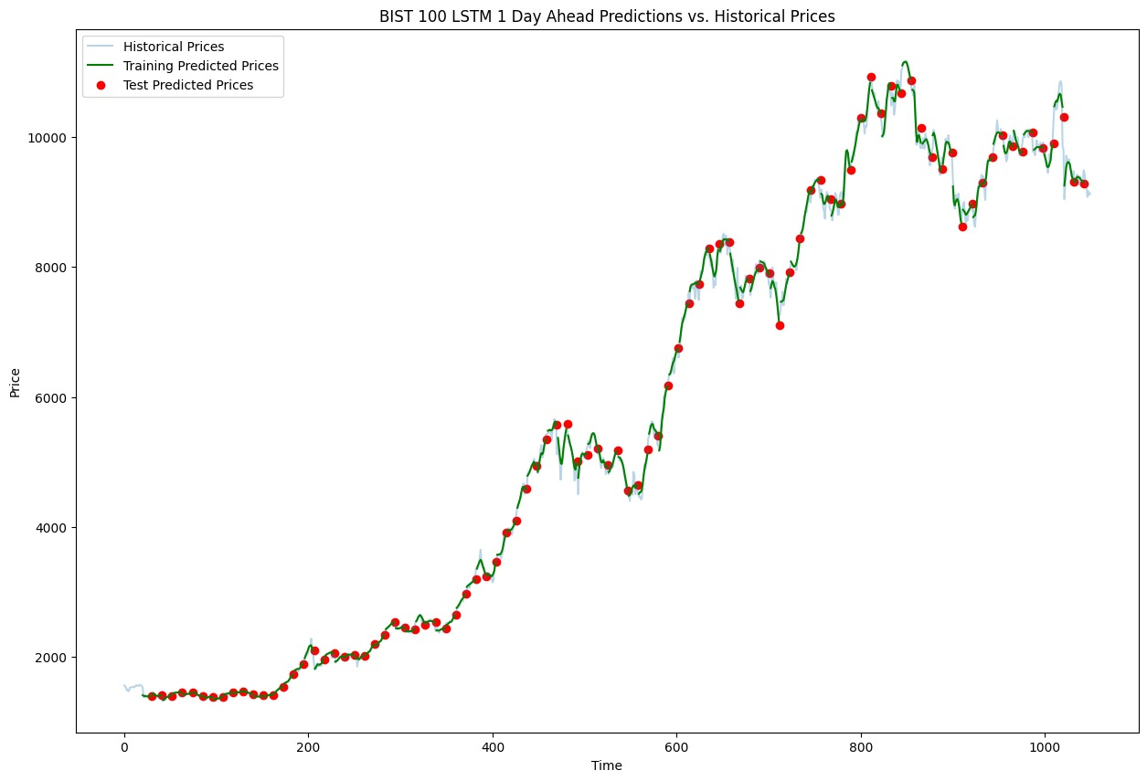
1 Day PREDICTIONS, lstm
 | TRAIN | TEST
RMSE | 67.98 | 142.62
R² | 0.9995 | 0.9981
MAE | 42.66 | 104.1519
MAPE | 0.007 | 0.0186
Accuracy | 99.24 | 98.175

Slide 34
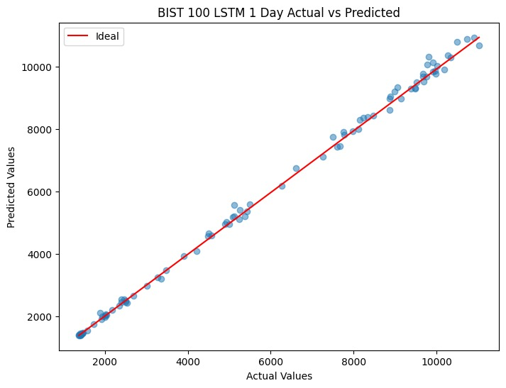
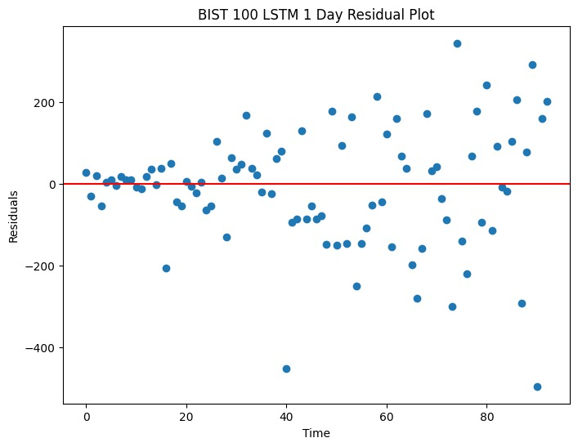
1-Day PREDICTIONS, lstm

Slide 35
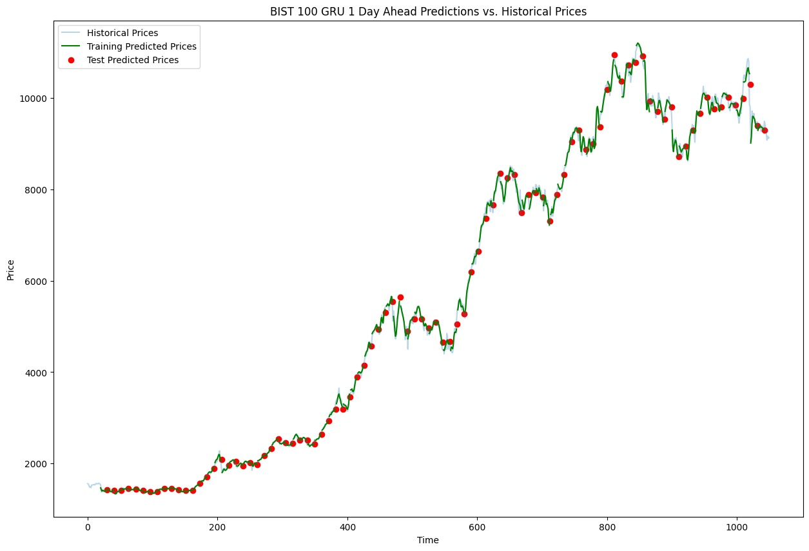
1-Day PREDICTIONS, GRU
 | TRAIN | TEST
RMSE | 63.56 | 131.39
R² | 0.9996 | 0.9984
MAE | 40.165 | 93.408
MAPE | 0.007 | 0.0171
Accuracy | 99.29 | 98.363

Slide 36
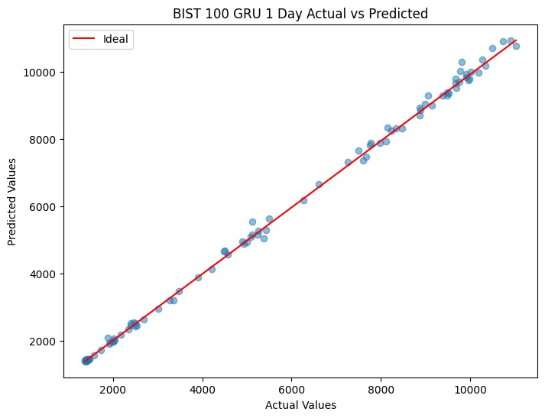
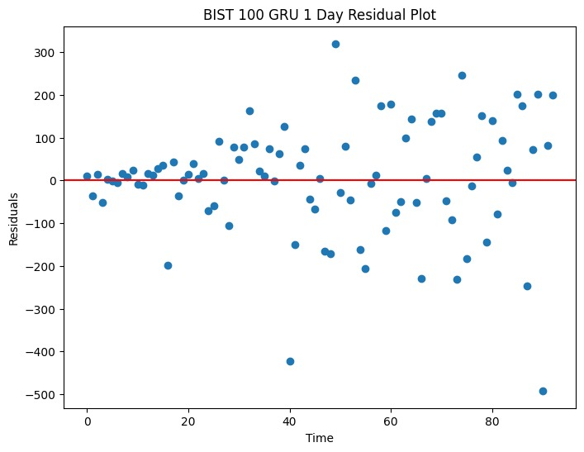
1-Day PREDICTIONS, GRU

Slide 37
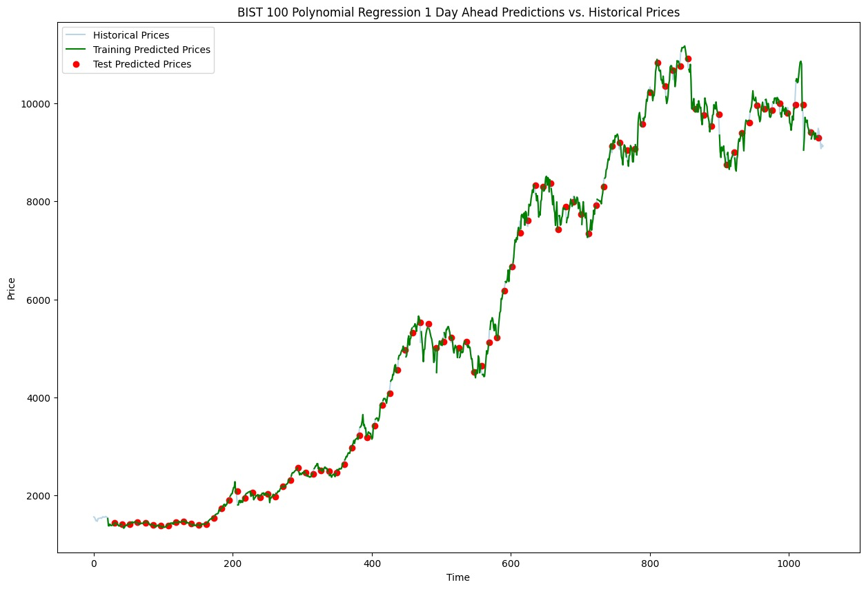
1-Day PREDICTIONS, POLYNOMIAL REGRESSION
 | TRAIN | TEST
RMSE | 3.30e-13 | 113.78
R² | 1 | 0.9988
MAE | 9.53e-14 | 85.644
MAPE | 1.785e-17 | 0.016
Accuracy | 100 | 98.499

Slide 38
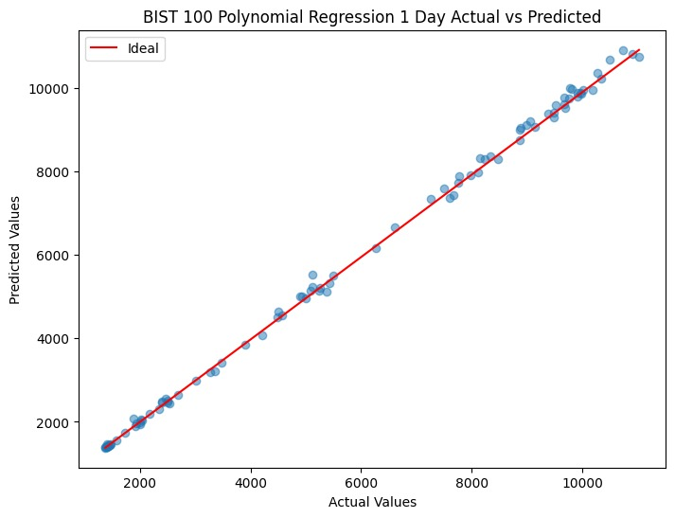
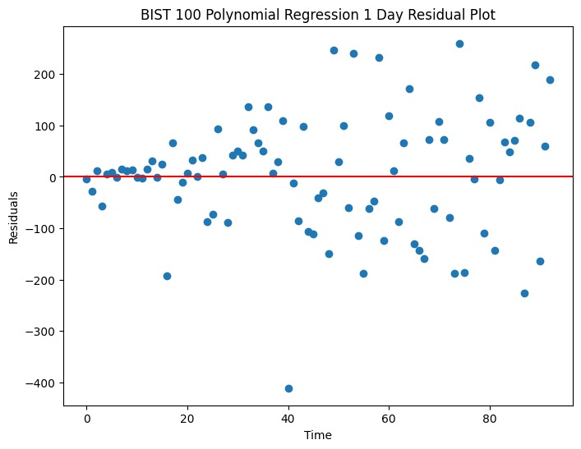
1-Day PREDICTIONS, POLYNOMIAL REGRESSION

Slide 39
COMPARISON, 1-day predıctıons
LSTM
GRU
Polynomial Regression
 | TRAIN | TEST
RMSE | 67.98 | 142.62
R² | 0.9995 | 0.9981
MAE | 42.66 | 104.1519
MAPE | 0.007 | 0.0186
Accuracy | 99.24 | 98.175
 | TRAIN | TEST
RMSE | 63.56 | 131.39
R² | 0.9996 | 0.9984
MAE | 40.165 | 93.408
MAPE | 0.007 | 0.0171
Accuracy | 99.29 | 98.363
 | TRAIN | TEST
RMSE | 3.30e-13 | 113.78
R² | 1 | 0.9988
MAE | 9.53e-14 | 85.644
MAPE | 1.785e-17 | 0.016
Accuracy | 100 | 98.499

Slide 40
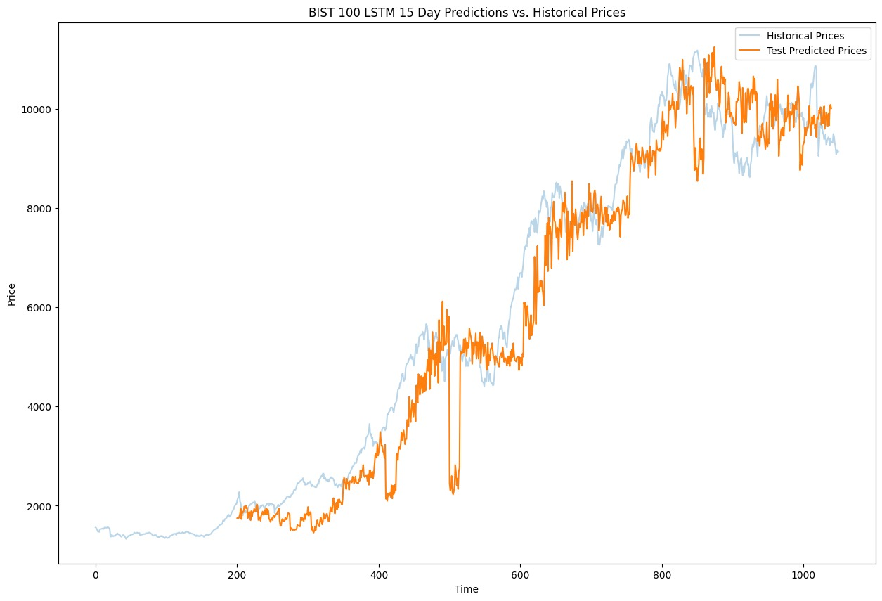
15 Day PREDICTIONS, LSTM
 | TRAIN | TEST
RMSE | 153.164 | 883.97
R² | 0.997 | 0.92369
MAE | 104.82 | 668.718
MAPE | 0.0224 | 0.1641
Accuracy | 98.178 | 89.808

Slide 41
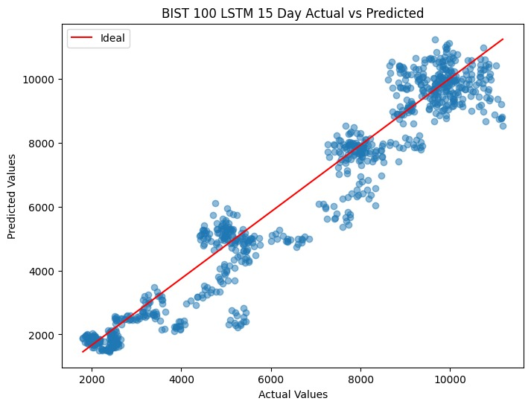
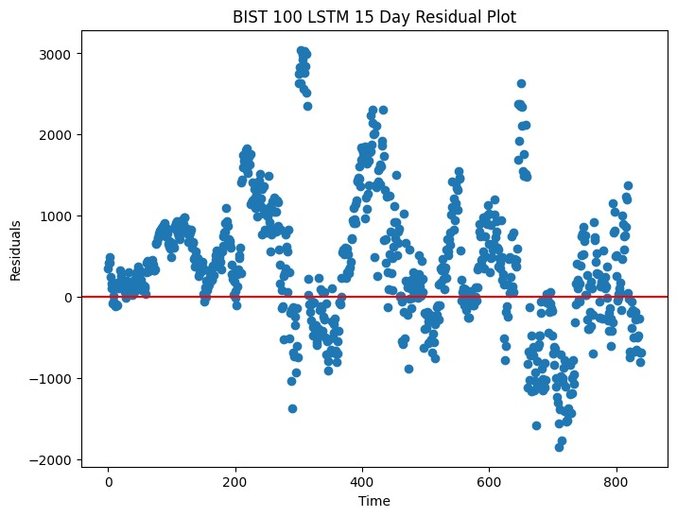
15-Day PREDICTIONS, LSTM

Slide 42
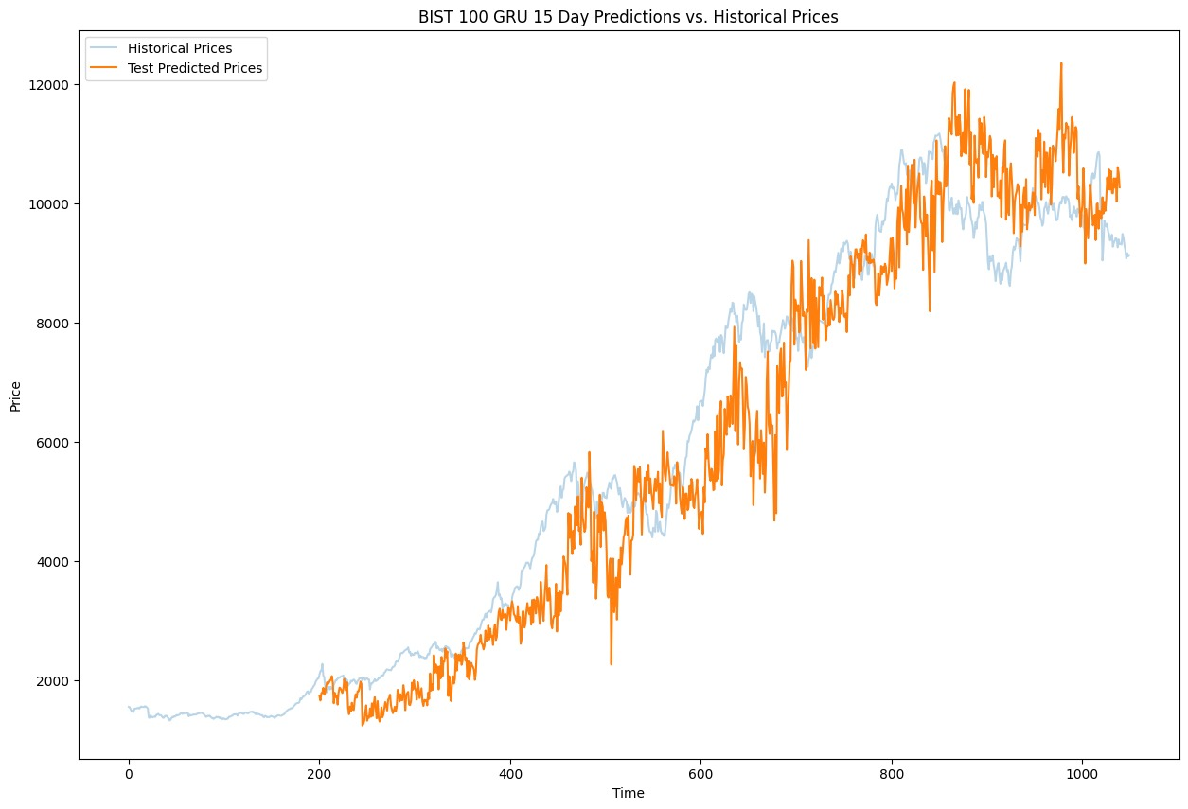
15-Day PREDICTIONS, GRU
 | TRAIN | TEST
RMSE | 209.57 | 1042.112
R² | 0.9955 | 0.903
MAE | 144.45 | 840.02
MAPE | 0.0309 | 0.1781
Accuracy | 97.489 | 87.19

Slide 43
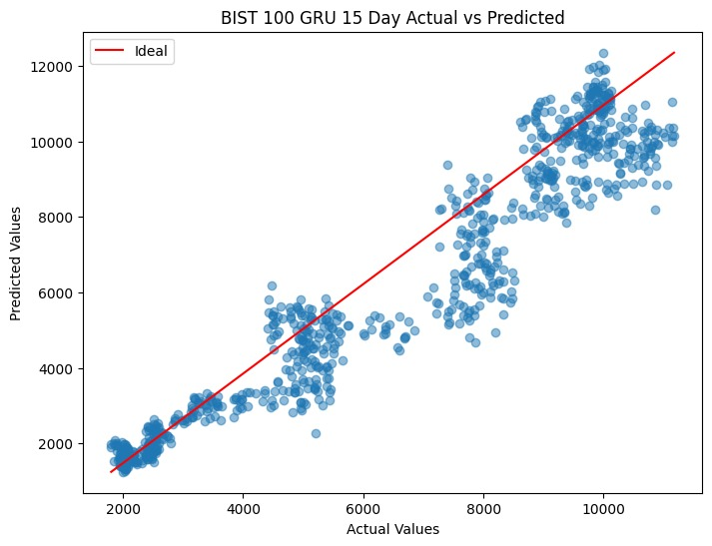
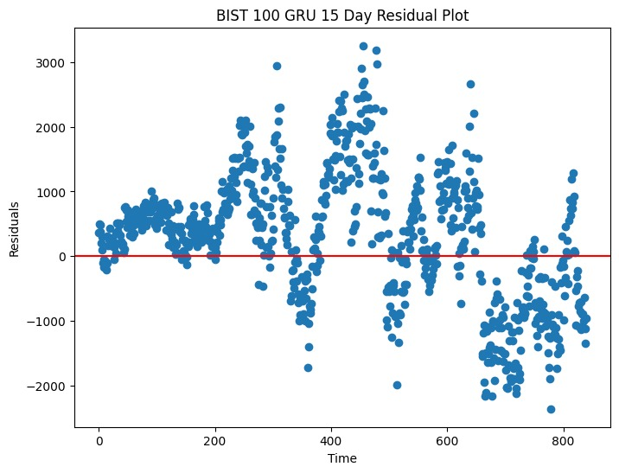
15 Day PREDICTIONS, gru

Slide 44
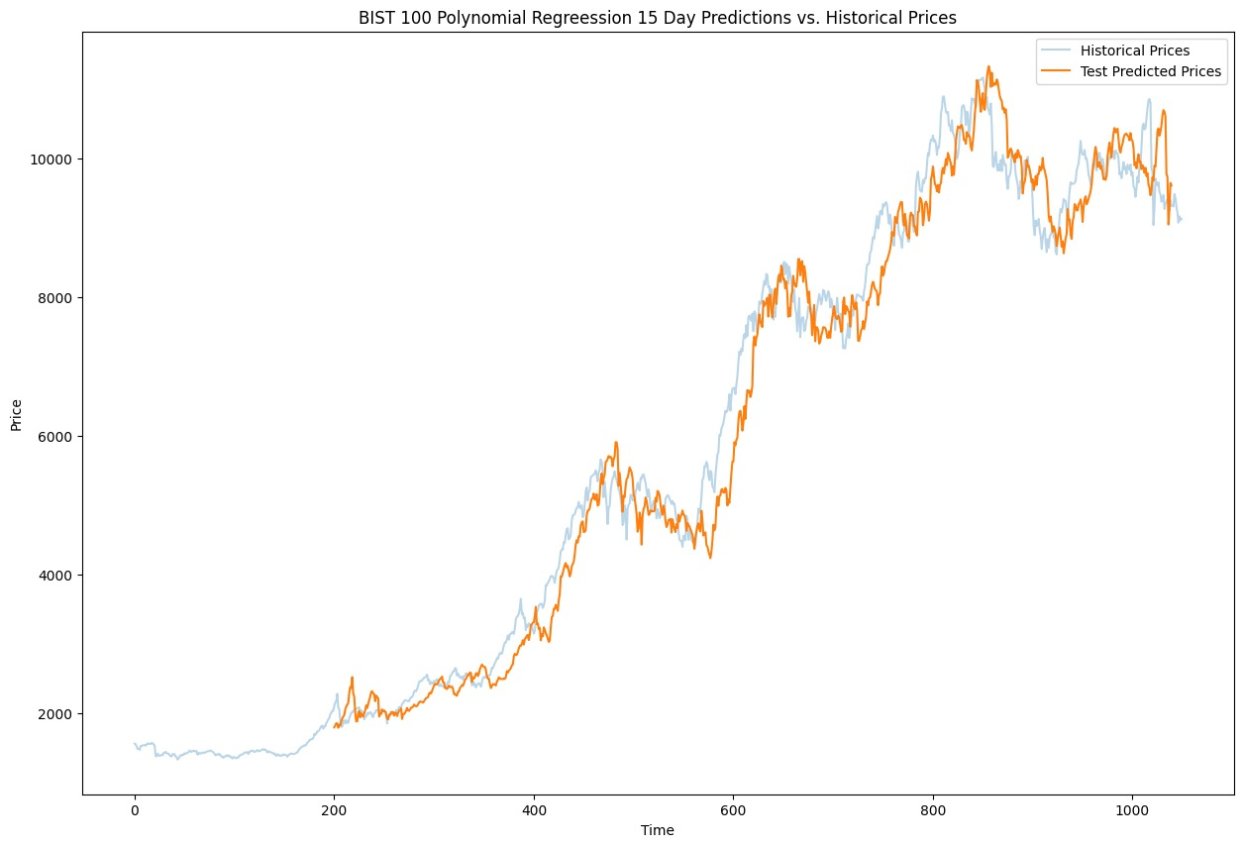
15-Day PREDICTIONS, POLYNOMIAL REGRESSION
 | TRAIN | TEST
RMSE | 1.34e-12 | 504.449
R² | 1 | 0.972589
MAE | 8.419e-13 | 395.69739
MAPE | 1.67876e-16 | 0.07067
Accuracy | 99.99 | 93.96921

Slide 45
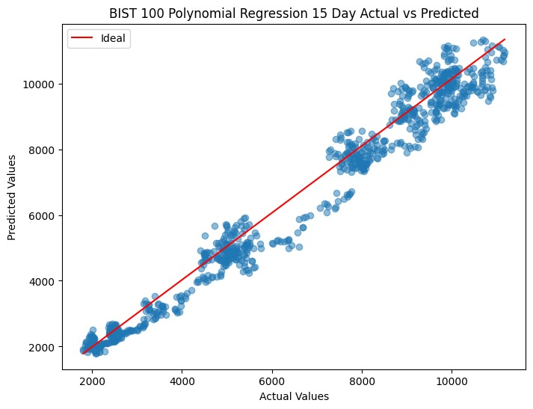
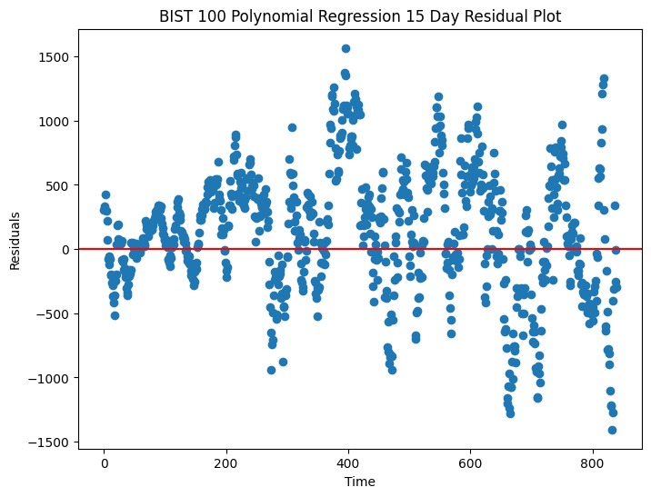
15-Day PREDICTIONS, POLYNOMIAL REGRESSION

Slide 46
COMPARISON, 15-day predıctıons
LSTM
GRU
Polynomial Regression
 | TRAIN | TEST
RMSE | 153.164 | 883.97
R² | 0.997 | 0.92369
MAE | 104.82 | 668.718
MAPE | 0.0224 | 0.1641
Accuracy | 98.178 | 89.808
 | TRAIN | TEST
RMSE | 209.57 | 1042.112
R² | 0.9955 | 0.903
MAE | 144.45 | 840.02
MAPE | 0.0309 | 0.1781
Accuracy | 97.489 | 87.19
 | TRAIN | TEST
RMSE | 1.34e-12 | 504.449
R² | 1 | 0.972589
MAE | 8.419e-13 | 395.6974
MAPE | 1.679e-16 | 0.07067
Accuracy | 99.99 | 93.96921

Slide 47
VIı. COnclusıon

Slide 48
conclusıon
Using walk-forward approach, we implemented LSTM, GRU, and polynomial regression models to make 1-day and 15-day predictions of BIST 100 Index. From our evaluation metrics we conclude that our models are sufficient to predict the 1-day values of BIST 100 Index. Although the accuracy of predictions are lower in times of sharply increased volatility, evaluation metrics indicate that 15-day predictions are decent. Their response the increased volatility can be addressed in further studies.

Slide 49
Thank you for lIstenIng to our presentatIon and for your tIme to joIn us.

